Slide 1
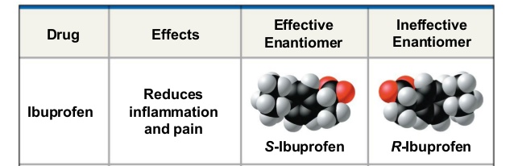
C13H18O2
C13H18O2

Slide 2
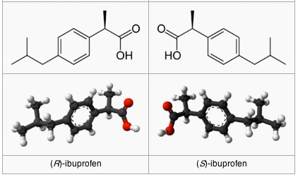

Slide 3
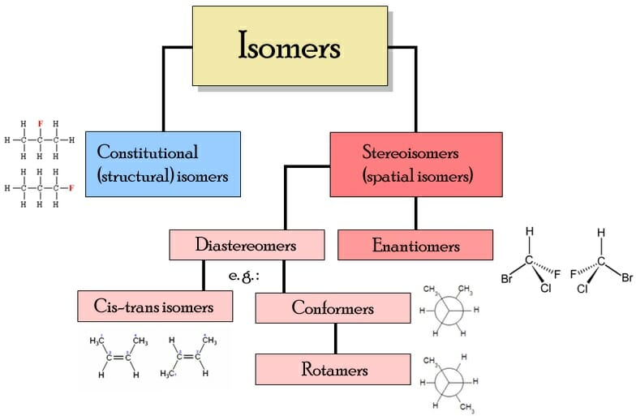
Same molecular formula.
Different structures and properties.
Different connectivities.
Similar connectivity.
Different spatial arrangements.
Not mirror images
Mirror image
Non-superimposable

Slide 4
Enantiomers
Mirror image
Non-superimposable

Slide 5
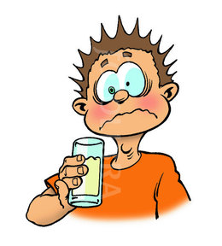
2-hydroxypropanoic acid
(Aka lactic acid!)

Slide 6
Connectivity
Mirror image
Superimposable
Similar
Yes
?

Slide 7
Connectivity | Similar
Mirror image | Yes
Superimposable
No

Slide 8
Molecules that are not identical to their mirror images are kinds of stereoisomers called Enantiomers
(Greek enantio, meaning “opposite”)

Slide 9
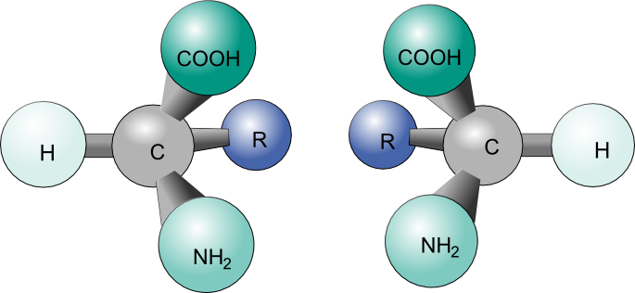

Slide 10
But there are some questions…
Do all the molecules have enantiomers?
What kind of molecules can be enantiomers?

Slide 11

Chirality

Slide 12
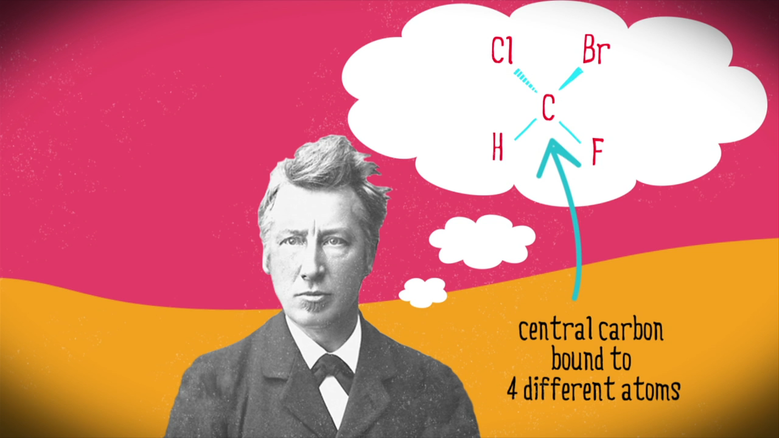

Slide 13
Our hands aren’t identical; rather, they’re nonsuperimposable mirror images.

Slide 14
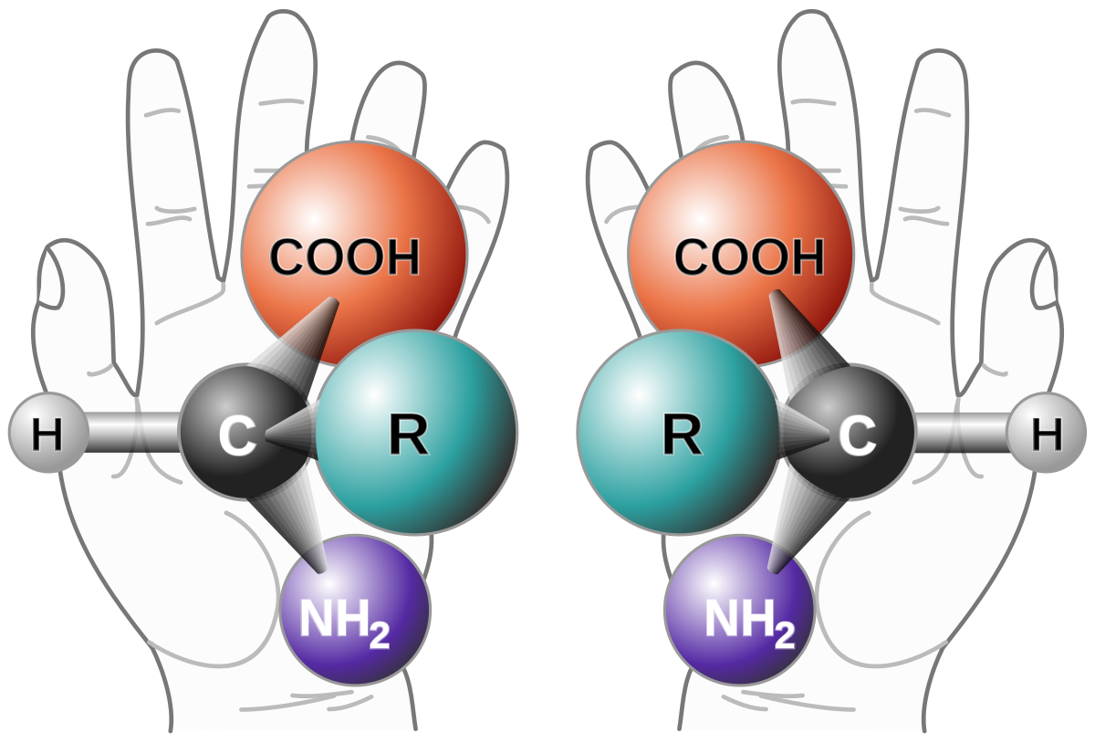
A molecule that is not identical(non-superimposable) to its mirror image is said to be chiral.
(ky-ral,from the Greek cheir, meaning “hand”).

Slide 15
A molecule is not chiral (achiral) if it has a plane of symmetry

Slide 16
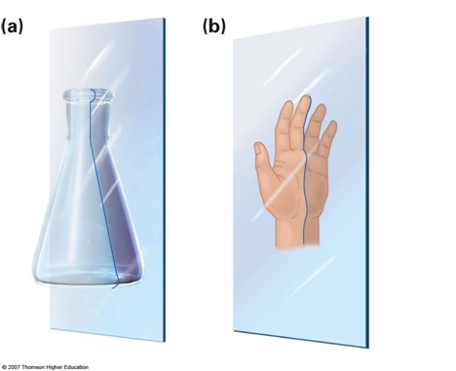

Slide 17
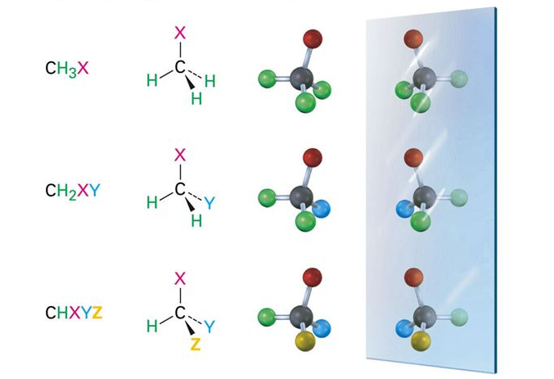

Slide 18
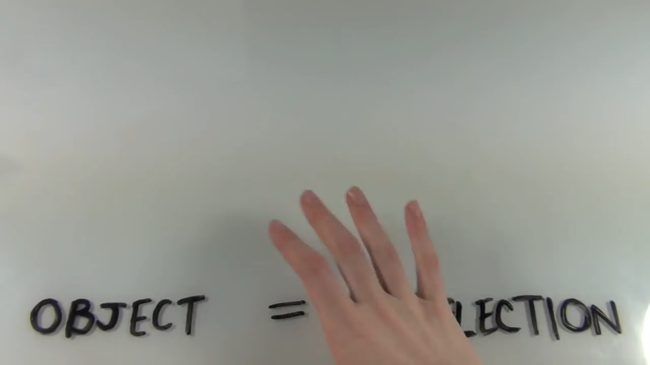

Slide 20
Chirality Center
(stereocenter, asymmetric center, stereogenic center)
Tetrahedral carbon atom bonded to four different groups

Slide 21
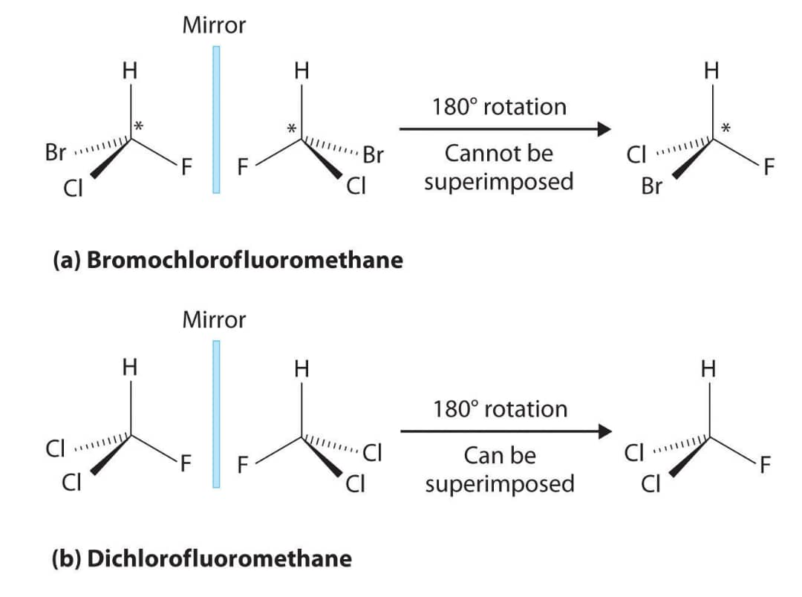

Slide 22
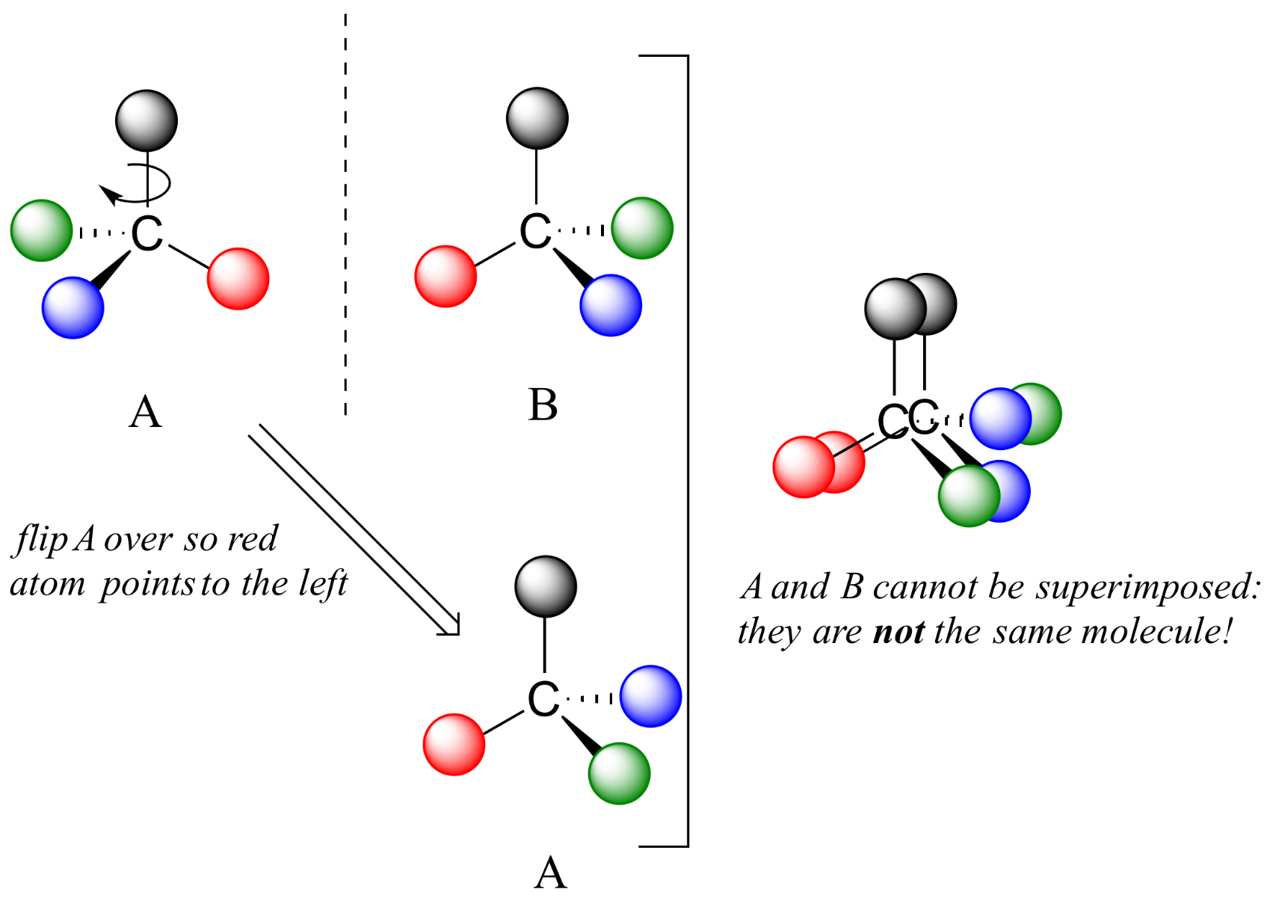

Slide 24
So…
The existence of enantiomers are determined by a concept known as chirality.
The mirror image of a chiral molecule (one without a plane of symmetry) is its isomer called Enantiomers.

Slide 25
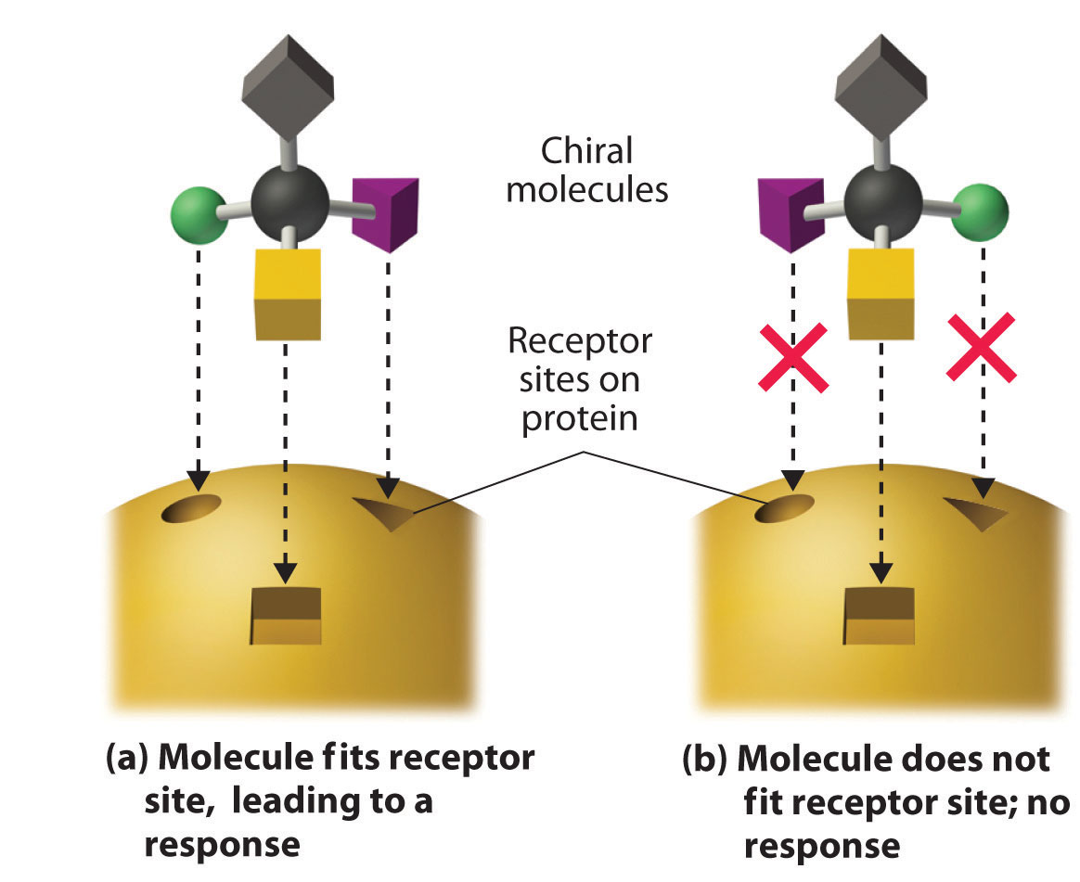
Now what?
Enzymes in our body often distinguish between the two enantiomers of a chiral substance.

Slide 26
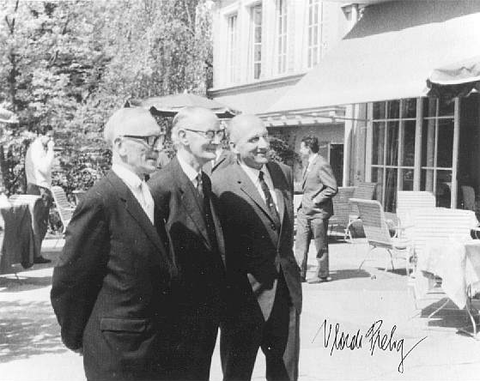
Stereochemical Configuration
Cahn-Ingold-Prelog
Rules

Slide 27
Rule 1
Look at the four atoms directly attached to the chirality center
Now rank them according to atomic number.
Higher atomic number higher priority 1

Slide 28
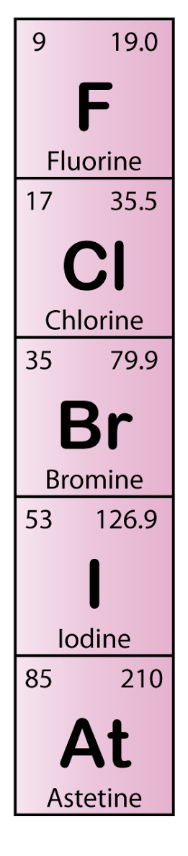
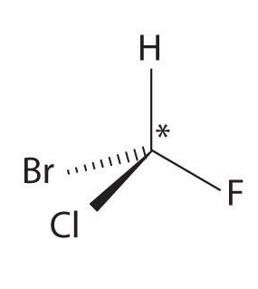
Bromochlorofluoromethane
4
1
3
2

Slide 29
Rule 2
If a decision can’t be reached by ranking the first atoms in the substituent, look at the second, third, or fourth atoms away from the chirality center until the first difference is found.

Slide 30
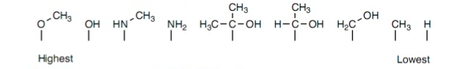
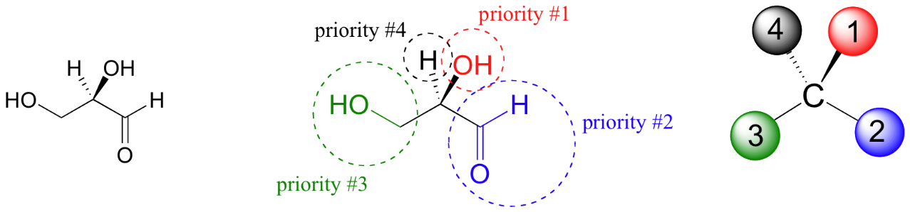

Slide 31
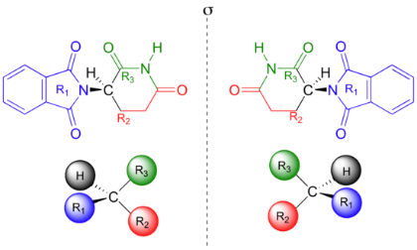

Slide 32
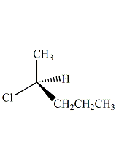
3
4
1
2

Slide 33
Rule 3
Multiple-bonded atoms are equivalent to the same number of single-bonded atoms.

Slide 35
If a curved arrow drawn from the highest to second-highest to third-highest ranked substituent (1 , 2 , 3) is clockwise,
we say that the chirality center has the R configuration
(Latin rectus, meaning “right”)

Slide 36
If an arrow from 1 , 2 , 3 is counterclockwise,
the chirality center has the
S configuration
(Latin sinister, meaning “left”)

Slide 37
S
R
S

